Slide 1
Cell Structure & Function
Lecture 1

Slide 2
Objectives
Understand/know/focus on/note
what the 3 "domains" of life are
what features are in the eukaryotic cell
3 features common between all domains are
describe or define the following terms: cytosol, cytoplasm, organelle, nucleus, plasma membrane/cell membrane
what limits cell size
two kinds of microscopy (light, electron) and what they see
two kinds of electron microscopy (TEM, SEM)
examples of how cell structure is optimizied to its function

Slide 3
Goals of a Cell & Organism
Maintain its survival
Done by achieving a metabolic stability or homeostasis (not chemical equilibrium)
Perpetuate its kind (species)
Mechanisms for cellular longevity
Mechanisms for cellular / organismal dormancy
Mechanisms to create genetic diversity during sexual reproduction in order to adapt to changing environments

Slide 4
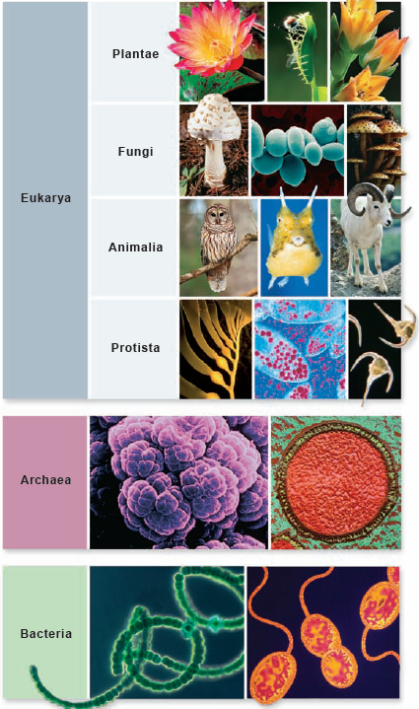
Biological World
Domains (Woese)
Archaea
Bacteria
Eukarya (eukaryotes)
Four kingdoms
uni- and multicellular organisms
} (prokaryotes)

Slide 5
Comparing The Domains
A Comparison of Some Properties of Bacterial, Archaeal, and Eukaryotic Cells*
 | Prokaryotes
Property | Bacteria | Archaea | Eukaryotes
Typical size | Small (1–5 µm) | Small (1–5 µm) | Large (10–100 µm)
Nucleus and organelles | No | No | Yes
Microtubules and microfilaments | Actin-like and tubulin-like proteins | Actin-like and tubulin-like proteins | Actin and tubulin proteins
Exocytosis and endocytosis | No | No | Yes
Cell wall | Peptidoglycan | Varies from proteinaceous to peptidoglycan-like | Cellulose in plants, fungi; none in animals, protozoa
Mode of cell division | Binary fission | Binary fission | Mitosis or meiosis plus cytokinesis
Typical form of chromosomal DNA | Circular, few associated proteins | Circular, associated with histone-like proteins | Linear, associated with histone proteins
RNA processing | Minimal | Moderate | Extensive
Transcription initiation | Bacterial type | Eukaryotic type | Eukaryotic type
RNA polymerase | Bacterial type | Some features of both bacterial, eukaryotic types | Eukaryotic type
Ribosome size and number of proteins | 70S with 55 proteins | 70S with 65 proteins | 80S with 78 proteins
Ribosomal RNAs | Bacterial type | Archaeal type | Eukaryotic type
Translation initiation | Bacterial type | Eukaryotic type | Eukaryotic type
Membrane phospholipids | Glycerol-3-phosphate + linear fatty acids | Glycerol-1-phosphate + branched polyisoprenoids | Glycerol-3-phosphate + linear fatty acids
from Table 4-1 in Hardin, Bertoin, Kleinsmith (eds.) Becker's World of The Cell, 8th Ed, 2012

Slide 6
Prokaryotes
Bacteria
Common features with eukaryotes
cytoplasm
plasma membrane
DNA organized as chromosome
Unique features
cell wall
capsule
pili
flagella
Missing features
nucleus & other membranous organelles

Slide 7
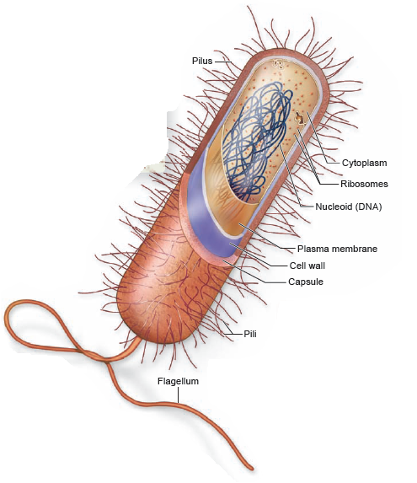
Generalized Bacterial Cell
Flagellum
motility
Pilus
attachment
exchange of genetic material with other bacteria
cell wall
integrity under stress (changes in osmolarity)
capsule
attachment
virulence

Slide 8
Eukaryotic Cells
Basics
plasma (cell) membrane
nucleus
cytoplasm
cytosol
organelles
Organelles
mitochondria
endoplasmic reticulum
Golgi complex
lysosomes (animals)
peroxisomes
chloroplasts (plants)
vacuole (plants)
primary & secondary walls (plants)

Slide 9
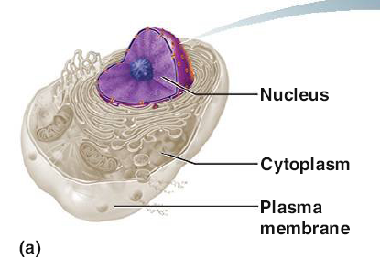
Eukaryote Basics Visualized
No cell wall
Organelle-rich cytoplasm

Slide 10
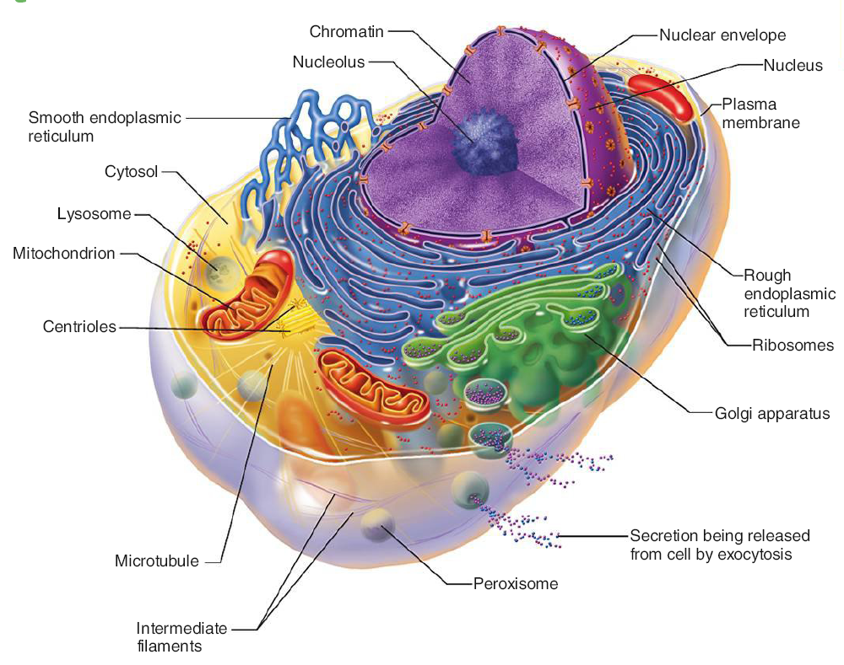
View of Animal Cell Features

Slide 11
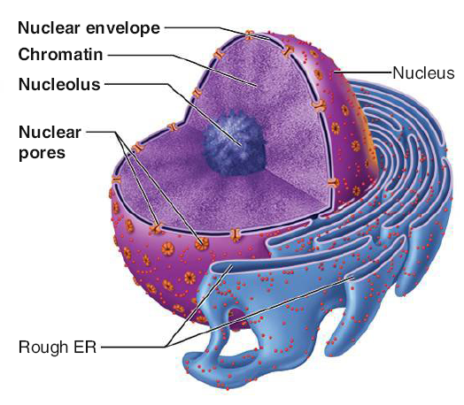
Detail of Nucleus & ER
Continuity of nuclear envelope with ER "endomembrane system"
Nuclear pores

Slide 12
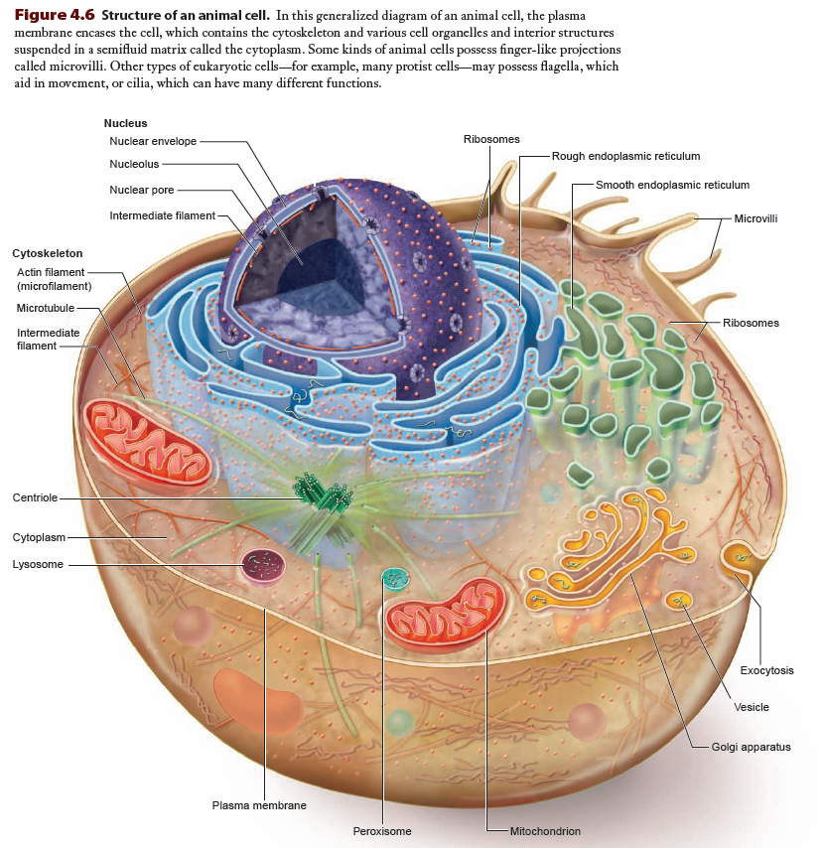

Slide 13
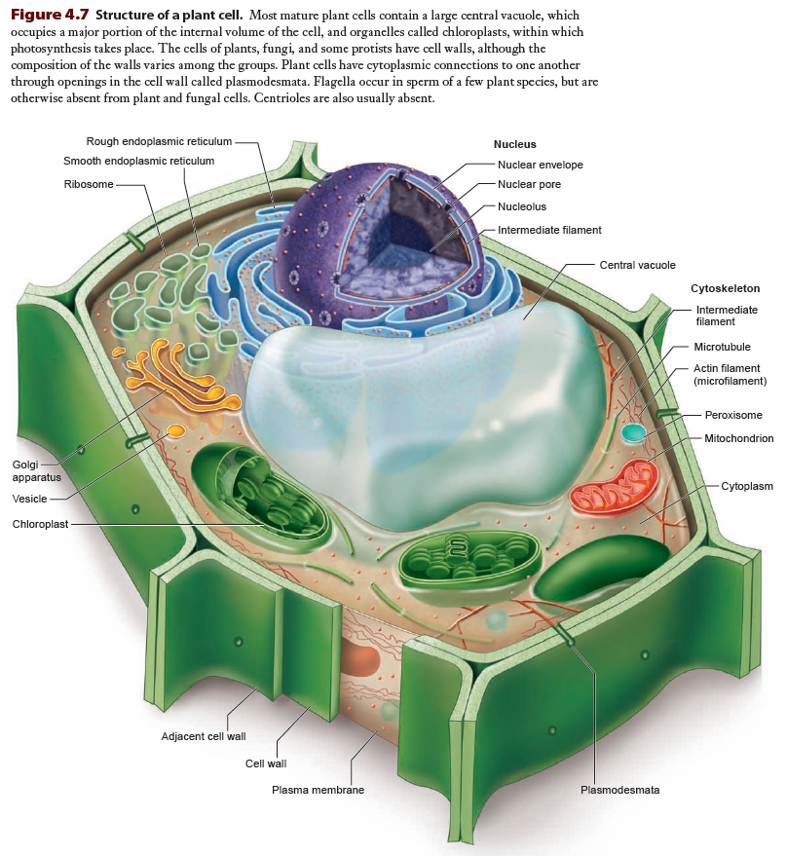

Slide 14
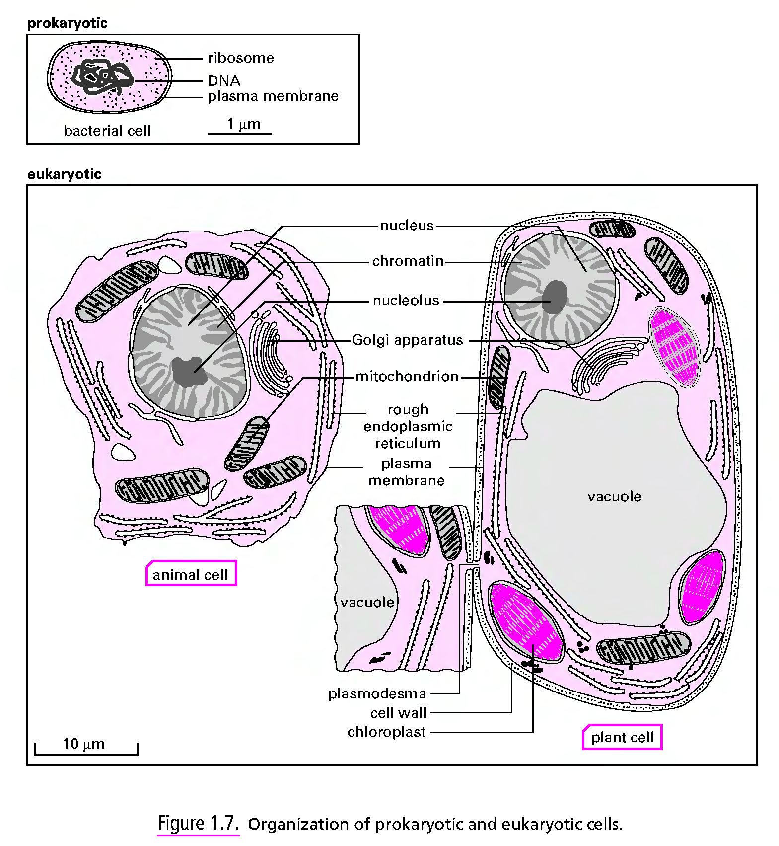

Slide 15
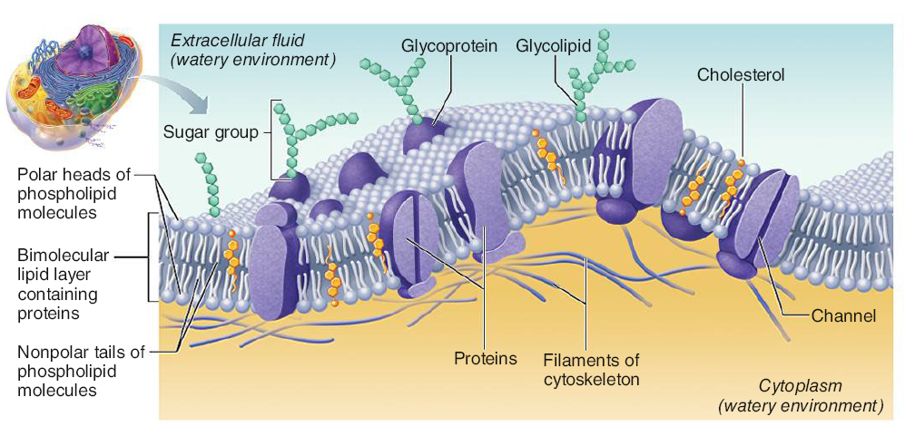
Animal Cell Plasma Membrane

Slide 16
Terms/Definitions/Descriptions
Cytoplasm
The cell contents bounded by the cell's plasma membrane and excluding the nucleus (for eukaryotes)
It is composed of cytosol and the cell's organelles
Cytosol
a viscous matrix composed of a water solvent and solutes that supports cell metabolism, structure and function
the solutes are small metabolites and large biomolecules: carbohydrates, lipids, amino acids, proteins
Organelle
definitions vary widely!!
minimum (safest and actually smartest) definition is a subcellular structure usually bounded by a membrane

Slide 17
Terms/Definitions/Descriptions
Plasma Membrane / Cell Membrane
a structure that encloses the contents (cytoplasm, nucleus) of a cell from its environment
usually composed of a bilayer of polar lipids with interspersed proteins specific for the cell interacting with its surroundings
Nucleus
Found only in eukaryotes, it contains the genetic information (DNA) specifying the structure and function of the cell and is responsible for organizing the timely expression and copying (during cell replication) of that information

Slide 18
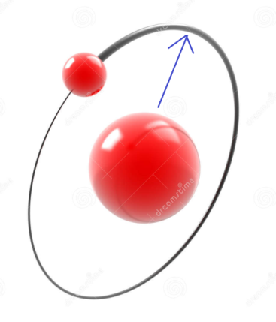
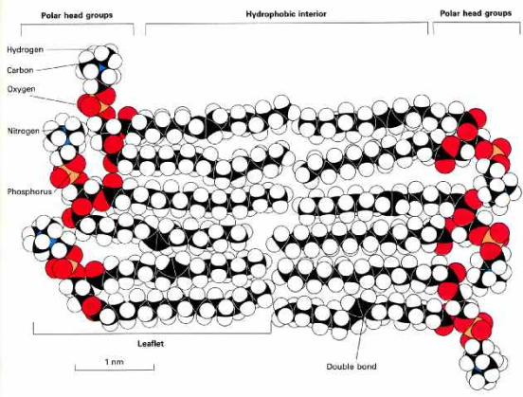
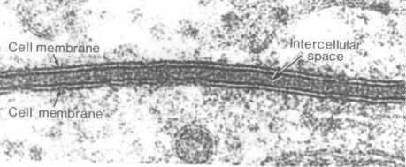
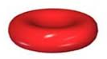
Thinking About Size
Hydrogen atom radius
0.5 Å = 50 pm = 0.05 nm = 5 × 10⁻¹¹ m
Cell membrane bilayer
5 nm = 50 Å = 5 × 10⁻⁹ m = 100 × H atom radius
Red blood cell
7 µm = 7000 nm = 70,000 Å = 7 × 10⁻⁶ m = 140,000 × H atom radius

Slide 19
Size & Geometry
Larger cells have lower surface area-to-volume ratios
given a spherical cell: volume (r³) increases more rapidly than surface area (r²) as a cell gets larger
Biomolecules diffuse in, out and through the cell
Cell can only be as big as the biomolecules vital to its survival can efficiently be at physiologically important locations
Rate of diffusion dependencies
cell surface area
concentration gradients
temperature
traversal distance

Slide 20
Size Limitations
Cell must have enough surface area to accommodate nutrients entering and wastes exiting for its volume
Cell must not be so big such that limits on nutrient and waste substance diffusion causes a stressful (toxic/deficient) condition
Biochemical reactions depend on maintaining adequate concentrations of reactants and enzymes, more easily done in a smaller containing space than a larger one

Slide 21
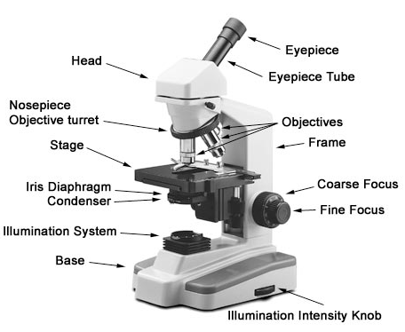
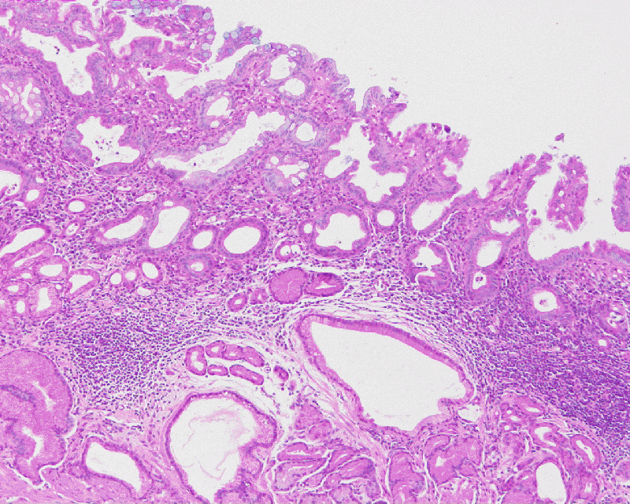
Seeing Structure: Light Microscopy
Light Microscopy
resolution barely below 1 µm
brightfield
must use stains to provide contrast
would use to see stained tissue sections
e.g. hematoxylin-and-eosin (H&E) of
stomach wall (figure)
phase contrast
imaging living cells in culture/fluid medium
http://www.nikon.com/products/instruments/resources/tech/guide/overview/img/pic_06.jpg

Slide 22
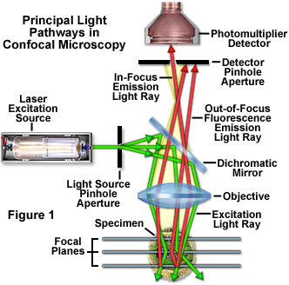
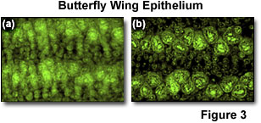
Seeing Structure: Light Microscopy
confocal
reduces flare problem in fluorescence microscopy
able to focus within narrow field of depth
creates sharper images
can generate 3D images with rapid automated positioning

Slide 23
Seeing Structure: Electron Microscopy
Transmission Electron Microscopy (TEM)
specimens fixed (dehydrated & embedded in resin/plastic) are sectioned in an ultra-microtome (50-100 nm thick), then coated/stained with electron-dense, electron-scattering metal salts (often lead or uranium) to improve contrast
Best magnifications: resolve objects separated by 0.2 nm
Scanning Electron Microscopy (SEM)
specimens fixed & dehydrated resin/plastic) then coated/stained with electron-dense, electron-scattering metal salts (gold/palladium) to improve imaging
Best magnifications: resolve objects separated by 10 nm

Slide 24
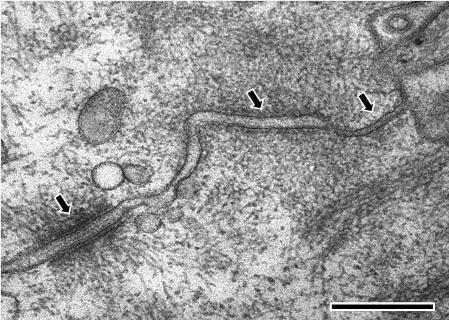
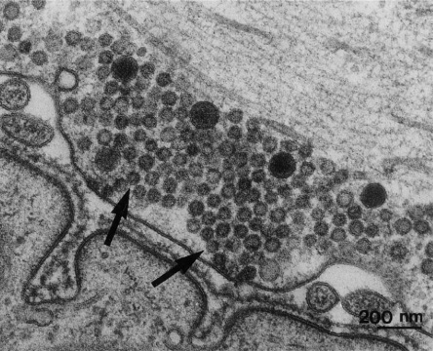
TEM Examples
http://starklab.slu.edu/neuro/nmj.jpg
http://www.mechanobio.info/figure/1384242441141.jpg.html
Electron microscopy image of rat intestinal mucosa epithelial cell-cell junctions. The cell is orientated such that the top right hand corner is apical and the bottom left hand corner is more basal. .From left to right; the first arrow points to a desmosome with dense desmosomal plaques seen either side of the intercellular space of approximately 240 angstroms in width, the second arrow points to an adherens junction with an intercellular space of approximately 200 angstroms and the third arrow points towards a tight junction that shows close apposition of the plasma membrane leaflets, as inferred from the absence of an intercellular gap. (Scale bar 250 nm).
TEM of a neuromuscular junction, with axon terminal containing numerous vesicles on top and evaginated folds to increase surface contact with muscle cell on bottom. Electron-dense material is in the intercellular space

Slide 25
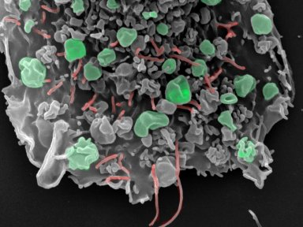
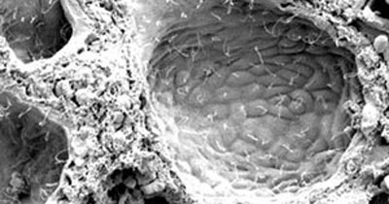
SEM Examples
http://www.lincoln.ox.ac.uk/Undergraduates-Subjects-Medicine
http://www.mayo.edu/research/~/media/kcms/gbs/research/images/2013/05/19/11/02/cilated-cholangiocytes-index.ashx
Scanning electron micrograph of ciliated cholangiocytes lining each liver cyst in an autosomal recessive polycystic kidney disease animal model.
Scanning electron micrograph of the effect the human breast cancer-associated gene has on cell behavior. The budding vesicles (green) generate fragments of cancer cell that can be detected in the blood and the adhesion processes (red) are altered making the cell less attached to its surroundings and more able to migrate to distant sites.

Slide 26
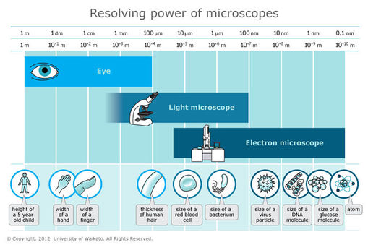

Slide 27
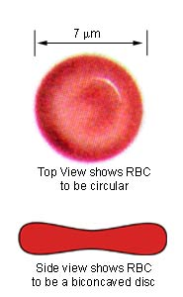
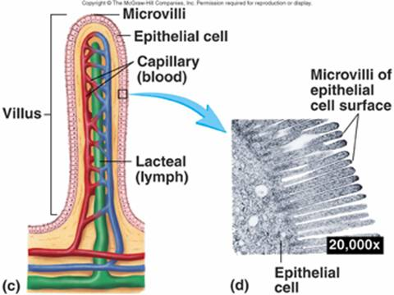
Structure-Function Optimization
Erythrocyte
Disk-shaped with biconcavity
Optimized for rapid association and dissociation of O₂ with the heme group enveloped by hemoglobin polypeptides within the RBC
Intestinal Epithelial Cell
situated on an intestinal villus to improve nutrient absorption
its apical (luminal) surface has microvilli to further improve nutrient absorption
http://www.biosbcc.net/doohan/sample/images/blood%20cells/RBC.jpg
http://www.rci.rutgers.edu/~uzwiak/AnatPhys/Digestive_System_files/image030.jpg

Slide 28
Subcellular Structures
Organelles ("little organs")
Mitochondria
Endoplasmic Reticulum (ER) / Endomembrane sys
"rough ER" (RER)
"smooth ER" (SER)
Golgi complex / apparatus
Lysosomes
Peroxisomes

Slide 29
Subcellular Structures
Other specialized features
Ribosomes (organelle?)
subunit macromolecular assemblies of dozens of proteins weaved around RNA polymers
Cytoskeleton
microfilaments, microtubules, intermediate filaments
Centrioles
Cilia
Flagella
Microvilli

Slide 30
Cells Are "Living"
Cells are the fundamental "unit" of "life" – the living thing
the organism can be a single cell or multicellular
Viruses
appear life-like in that they can perpetuate their existence in large numbers, replicate selves
without host cells, they cannot: no free-living existence
same applies to viroids and prions

Slide 31
Reading (Sources)
Marieb: part I of chapter 3
Becker's WotC: Chapter 4
Raven: Chap 4.2, 4.3,

